Slide 1

Pet Bay
Team – NPM Start
Member: Linjing Xie, Xin Lu, Jing Zou, Shuting Dai

Slide 2
Overview Of This Project
In this project, we developed a website for pet sitting and pet boarding.
The front end was designed by using Angular8 and the back end was designed by using Node.js, Express and MongoDB.
At the front end four modules were built, which are home module, pet-boarding module, pet-sitting module and user module.
At the backend RESTful api with CRUD operations was built, so we can fetch and process data stored in the database.

Slide 3
1.
Home

Slide 4
Home Page
Nav bar enables user to navigate to different pages
Show some cute images of the pets
Display the business range for the website
Sign up, Login, View Profile and Log out

Slide 5
2.
Pet-sitting

Slide 6
Pet sitting
View all the posts that need pet sitting services
Show the details of pet sitting posts, like pet type, time period and so on
Show the status of the posts: whether it is confirmed or not
Change the status of the posts
Users are able to create a new post

Slide 7
3.
Pet-boarding

Slide 8
Pet boarding
View all the posts that provides pet sitting services
Show the details of pet sitting posts, like price, time period and so on
Show the status of the posts: whether it is confirmed or not
Change the status of the posts
Users are able to create a new post

Slide 9
4.
User

Slide 10
Authentication
Use JWT token to accomplish authentication of users.
Enabled sign up, log in and log out.

Slide 11
User
Show information of the specific user.
List all the pets he or she has.
User can create, delete, update his or her pets.
List all the posters he or she posted.
User can create, delete, update his or her posters.

Slide 12
5.
Back End

Slide 13
Back End
Established the models for users, pets and posts.
Completed the data structure of users, pets and posts.
Use service and controller to accomplish CRUD operations.
Accomplished log in authentication by returning specific token string.

Slide 14
6.
Screen Shot

Slide 15
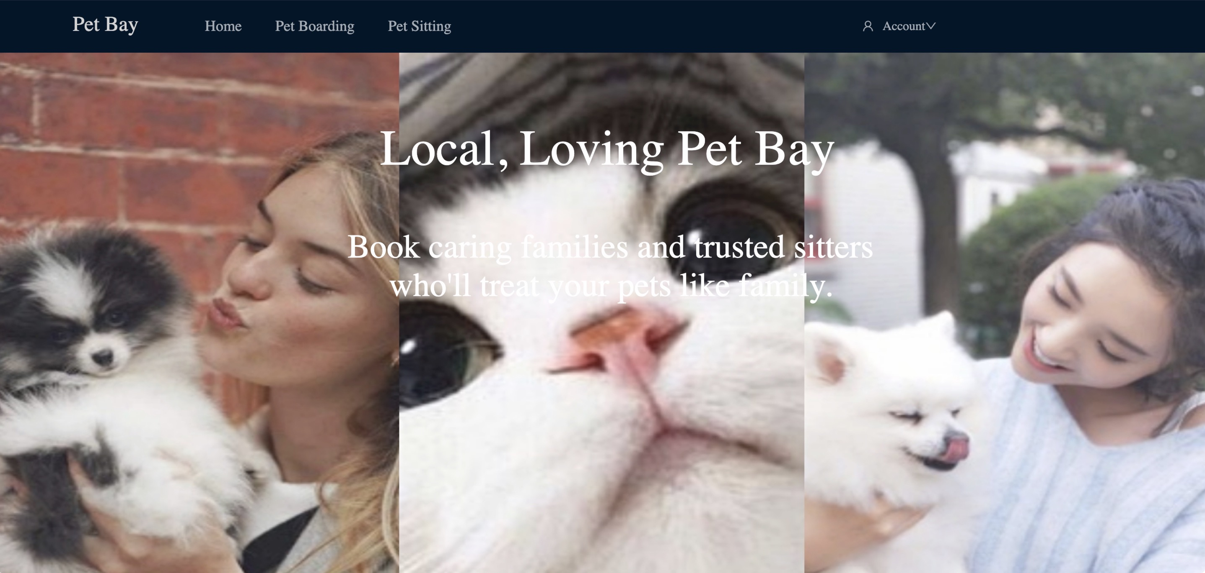

Slide 16
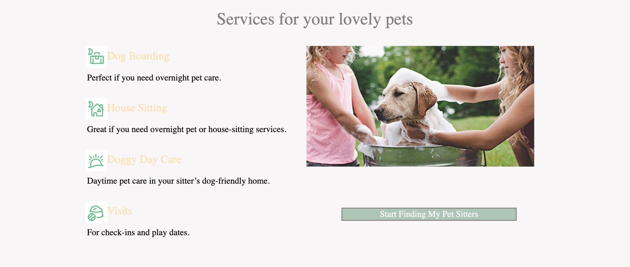

Slide 17
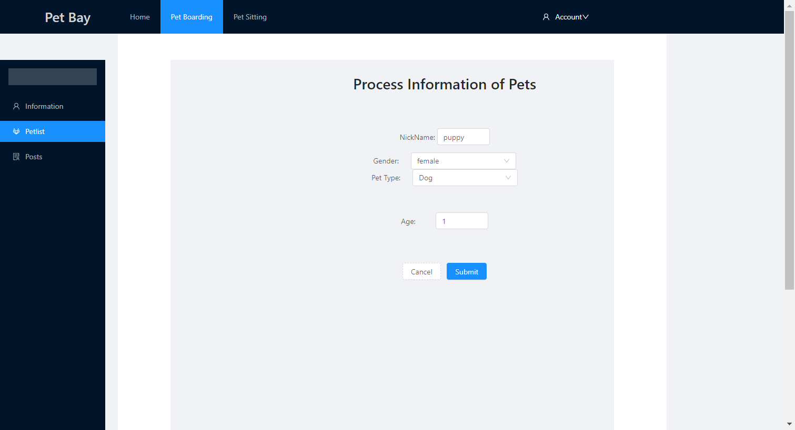

Slide 18


Slide 19
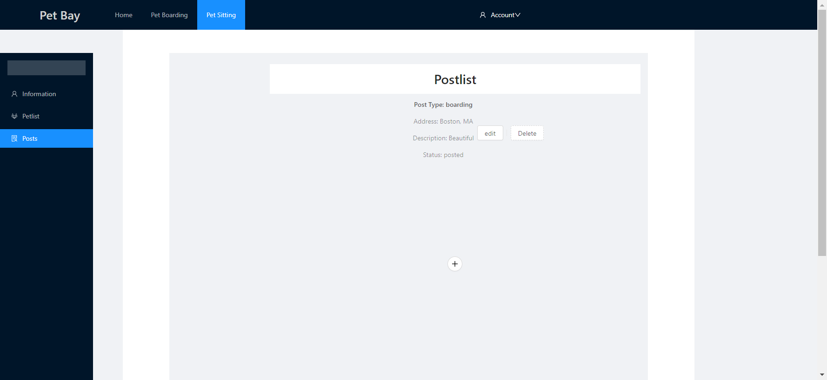

Slide 20
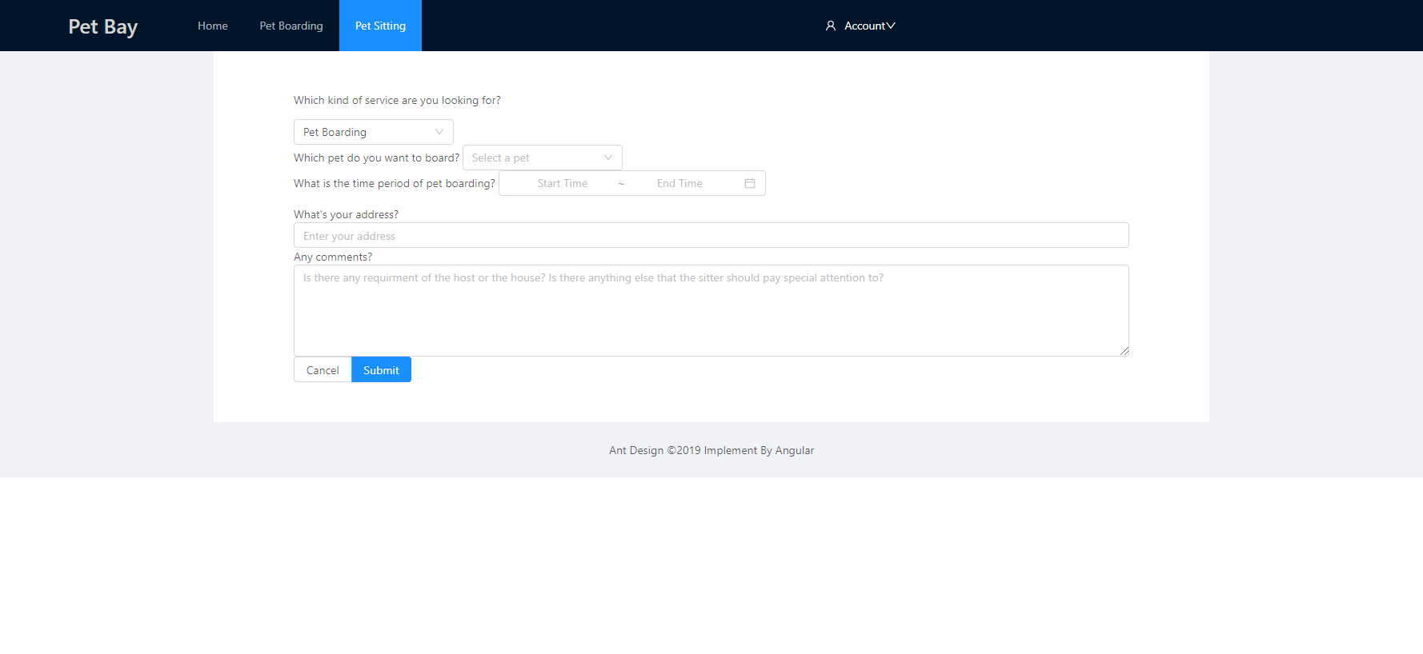

Slide 21
Thanks!

